Slide 1
Algorithm Recognition & Recommendation System
Richard Thai
Kurtis Zimmerman
Advisor
Dr. Chandan Rupakheti
Notes:
Richard

Slide 2
Problem Definition
Help novice programmers correctly implement common algorithms
Cases to consider
Incomplete source code
Compilable
Notes:
Kurtis
AST requires lots of heuristics,
CFG gives us more info to infer off of

Slide 3
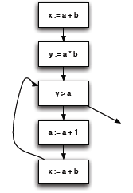
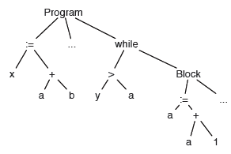
Problem Definition
x := a + b;
y := a * b;
while (y > a) {
a := a + 1;
x := a + b;
}
http://vinaytech.wordpress.com/2008/10/04/abstract-syntax-tree/
Notes:
Left is AST, right is CFG
Richard

Slide 4
Problem Definition
A
A
Delete D
Add F to C
B
C
B
C
D
E
E
G
A
Relabel A as G
B
C
B
C
E
F
E
F
Notes:
Kurtis

Slide 5
Pattern Definition Language
To define software patterns
Program Analysis Framework
To collect artifacts from a code base
and build a corresponding PDL model
Recommendation Engine
To evaluate differences between the
developer’s model and the PDL model
User Interface
To present the recommended
changes to the developer
Notes:
Progress
Graph matching
Recommendations
Eclipse
Richard

Slide 6
Pattern Definition Language
To define software patterns
Program Analysis Framework
To collect artifacts from a code base
and build a corresponding model
Recommendation Engine
To evaluate differences between the
developer’s model and the PDL model
User Interface
To present the recommended
changes to the developer
Notes:
Say what we intended to do with PDL, and why we stopped:
We’re replacing the PDL with an existing knowledge-base so that the user doesn’t need to learn a new language
We’d provide the source code in a repos that the user can add to as well, an added bonus
Kurtis

Slide 7
Overall Approach
Tree-matching problem
Suggest edits to correct implementation
Implement as an Eclipse plugin
Notes:
Converting a CFG to a tree (clarify a back-edge)
Why did we choose tree over graphs? Mention it here how graph matching algorithms don’t have the per4formance of tree-based comparisons. Mention the compromise of accuracy vs performance
Richard

Slide 8
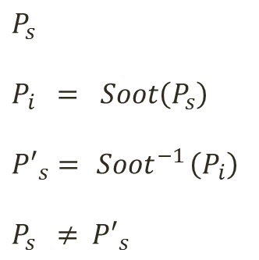
Control Flow Graphs (CFGs)
IR of Java code
Converted to a tree to benefit from performance gains of pq-gram
Issues:
- IR conversion is one-directional; recommendations are based off of the IR, not the source.
x := a + b;
y := a * b;
while (y > a) {
a := a + 1;
x := a + b;
}
$$P_{s}$$
$$P_{i} = Soot\left(P_{s}\right)$$
$${P′}_{s}={ Soot}^{−1}\left(P_{i}\right)$$
$$P_{s} ≠ { P′}_{s}$$
Notes:
The conversion is as simple as
P_s is the source code
To explain that decompiled will be lost with optimizations applied (not invertible)

Slide 9
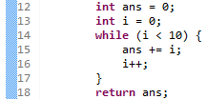

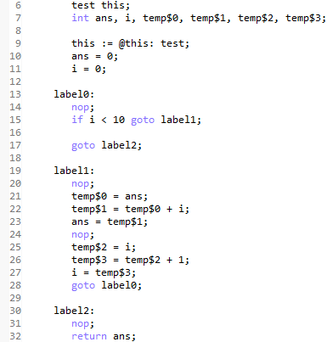
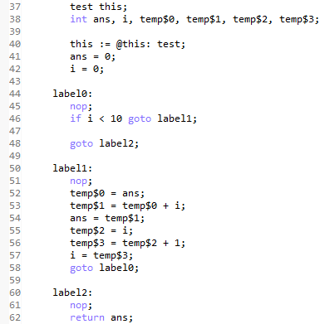
CFG Conversion
Notes:
Talk about syntactic vs semantic difference
Richard

Slide 10
Abstract Syntax Trees (ASTs)
Used to find syntactic differences
Tree edits can be effectively translated to source code edits because syntax is retained
Need not be compilable
Issues:
Cannot easily pinpoint behavioral equivalence
x := a + b;
y := a * b;
while (y > a) {
a := a + 1;
x := a + b;
}
Notes:
Kurtis

Slide 11
AST conversions
Converting for loops to a while structure
…
ForStatement
Expr.1 ConditionalExpr. Block Expr.2
…
Expr.1 WhileStatement
ConditionalExpr. Block Expr.2
Converting assignments to one common structure
e.g. x += 1 ⬄ x = x + 1
Notes:
Explain what the nodes represent
Kurtis

Slide 12
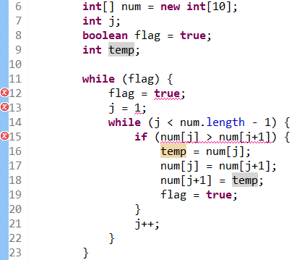
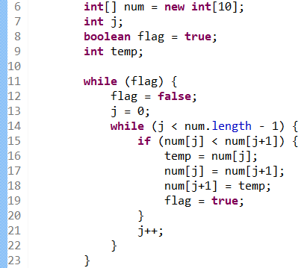
AST Demonstration
Identifies incorrect operators, tokens, identifiers
SOURCE TARGET
12: Change ‘true’ to ‘false’
13: Change ‘1’ to ‘0’
15: Change ‘>’ to ‘<‘
Notes:
Kurtis

Slide 13
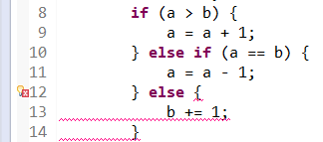
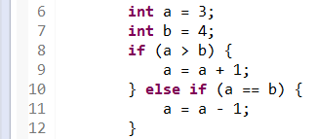
AST Demonstration
Identifies extra code
SOURCE TARGET
12: Delete extra code
Notes:
Kurtis

Slide 14
Combined approach
Utilize IR/AST-based approach to find best matching targets.
Find areas of difference in source and best matching target using CFG-based approach.
Use ASTs to find minimal recommendations based on known areas of difference.
Report source code edits to user.
Notes:
Use IR-base approaches to narrow candidates, much faster (file/string matching). Or even AST-based approach
Use-CFG to pinpoint edits, AST to make recommendations
Richard

Slide 15
Remaining Issues
How granular should the comparisons be for CFG-based approach?
Some syntactically different code may be semantically equivalent
a < b ⬄ b > a
Ordering of independent statements
a = x + y ⬄ b = w + z
b = w + z a = x + y
Not making interprocedural comparisons (points-to analysis)
Notes:
Richard, then Kurtis

Slide 16
Future directions
Experiment with two independent approaches
Which granularity works best for CFG?
Experiment with combined approach
Build set of incrementally complex test cases
Usability studies
Notes:
Richard

